Slide 1

Mirror, mirror, who is the fairest of them all? – Reflections on the design of and risk distribution in the mortgage systems of Denmark and the UK
Jesper Berg and Christian Sinding Bentzen
NIESR Conference
THE FUTURE OF HOUSING FINANCE
Third Annual Finance Conference
Friday the 12th September 2014

Slide 2
Jesper Berg
Member of Executive Board – Nykredit Bank
Regulatory Affairs and Rating
Christian Sinding Bentzen
Senior Analyst
Regulatory Affairs and Rating
Preview
“No other country allows borrowers to lock in fixed-rate 30-year mortgages and then to refinance their loans when rates fall. Nor should the US.”
Source: FT, Editorial, November 20, 2013

Slide 3
Jesper Berg
Member of Executive Board – Nykredit Bank
Regulatory Affairs and Rating
Christian Sinding Bentzen
Senior Analyst
Regulatory Affairs and Rating
Agenda
Literature review
The balance sheet of financial intermediaries
Comparing the Danish and UK mortgage system
Risk allocation in the Danish and UK system
The performance of the Danish and the UK system
The Danish and the UK system in a financial accounts perspective
Challenges in Denmark
Conclusions

Slide 4
Jesper Berg
Member of Executive Board – Nykredit Bank
Regulatory Affairs and Rating
Christian Sinding Bentzen
Senior Analyst
Regulatory Affairs and Rating
Literature Review
Campbell, John Y. (2012), “Mortgage Market Design”, National Bureau of Economic Research, working paper no. 18339.
Shin, Hyun S. (2010), “Financial intermediation and the post-crisis financial system”, BIS Working Papers, no. 304.
Allen, F. and Gale, D. (2001), “Comparing Financial Systems”, The MIT Press, Cambridge, MA.
Berg, J. Bentzen, C., Nielsen, M., Schönemann, H. (2013), “A Heavenly Match or Recent Developments in Mortgage Lending in the EU and Some Tentative Reflections on its Positioning in the Financial Structure”, in Property Prices and Real Estate Financing in a Turbulent World”, SUERF studies (2013/4), Vienna, AU.
Miles, D. (2004), “The Miles Review: The UK Mortgage Market: Taking a longer-term view”, HM Treasury, London, UK.
Independent Commission on Banking (ICB) (2011), “Final Report Recommendations”, Domarn Group, London, UK.

Slide 5
Jesper Berg
Member of Executive Board – Nykredit Bank
Regulatory Affairs and Rating
Christian Sinding Bentzen
Senior Analyst
Regulatory Affairs and Rating
The Balance Sheet of Financial Intermediaries
The UK covered Bond

Slide 6
Jesper Berg
Member of Executive Board – Nykredit Bank
Regulatory Affairs and Rating
Christian Sinding Bentzen
Senior Analyst
Regulatory Affairs and Rating
The Balance Sheet of Financial Intermediaries
The UK covered Bond
The typical structure of a UK regulated covered bond
The structure of a UK covered bond at default of issuer

Slide 7
Jesper Berg
Member of Executive Board – Nykredit Bank
Regulatory Affairs and Rating
Christian Sinding Bentzen
Senior Analyst
Regulatory Affairs and Rating
Comparing the Danish and UK Mortgage System
Source: EMF and national mortgage institutions.

Slide 8
Jesper Berg
Member of Executive Board – Nykredit Bank
Regulatory Affairs and Rating
Christian Sinding Bentzen
Senior Analyst
Regulatory Affairs and Rating
Risk Allocation in the Danish and UK System
Source: EMF and national mortgage institutions.

Slide 9
Jesper Berg
Member of Executive Board – Nykredit Bank
Regulatory Affairs and Rating
Christian Sinding Bentzen
Senior Analyst
Regulatory Affairs and Rating
The performance of the Danish and the UK system
Affordability
Outstanding loans and total issuance of covered bonds
Resilience towards falling house prices
Government intervention
Robustness during and after finansiel stress
A mortgage system should make it possible for households to acquire a home when they need it most i.e. early in an individual’s productive life when income and savings are likely to be lowest.
A mortgage system should be robust when house prices fall, e.g. a fall in house prices should not put the financial system at risk. The risks should be distributed to those who can handle them.
A mortgage system shall be able to continue to finance mortgage lending during and after a financial crisis.
Government involvement in the form of guarantees, regulatory benefits or other subsidies should be minimal.

Slide 10
Jesper Berg
Member of Executive Board – Nykredit Bank
Regulatory Affairs and Rating
Christian Sinding Bentzen
Senior Analyst
Regulatory Affairs and Rating
The performance of the Danish and the UK system
Affordability
Outstanding loans and total issuance of covered bonds
Resilience towards falling house prices
Government intervention
Robustness during and after finansiel stress
Source: Danmarks Nationalbank, Danmarks Statistik, Bank of England, Bloomberg, Nykredit Finans

Slide 11
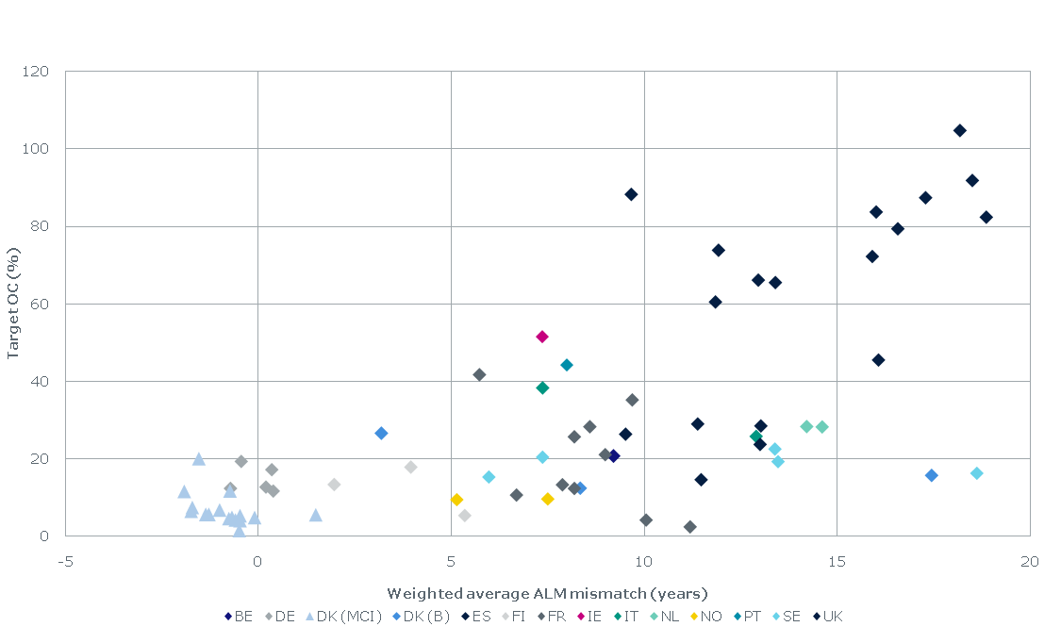
Jesper Berg
Member of Executive Board – Nykredit Bank
Regulatory Affairs and Rating
Christian Sinding Bentzen
Senior Analyst
Regulatory Affairs and Rating
The performance of the Danish and the UK system
Affordability
Outstanding loans and total issuance of covered bonds
Resilience towards falling house prices
Government intervention
Robustness during and after finansiel stress
Source: S&P’s own calculations

Slide 12
Jesper Berg
Member of Executive Board – Nykredit Bank
Regulatory Affairs and Rating
Christian Sinding Bentzen
Senior Analyst
Regulatory Affairs and Rating
The performance of the Danish and the UK system
Affordability
Outstanding loans and total issuance of covered bonds
Resilience towards falling house prices
Government intervention
Robustness during and after finansiel stress
Source: Council for Mortgage Lenders

Slide 13
Jesper Berg
Member of Executive Board – Nykredit Bank
Regulatory Affairs and Rating
Christian Sinding Bentzen
Senior Analyst
Regulatory Affairs and Rating
The performance of the Danish and the UK system
Affordability
Outstanding loans and total issuance of covered bonds
Resilience towards falling house prices
Government intervention
Robustness during and after finansiel stress
Source: Danmarks Statistik

Slide 14
Jesper Berg
Member of Executive Board – Nykredit Bank
Regulatory Affairs and Rating
Christian Sinding Bentzen
Senior Analyst
Regulatory Affairs and Rating
The performance of the Danish and the UK system
Affordability
Outstanding loans and total issuance of covered bonds
Resilience towards falling house prices
Government intervention
Robustness during and after finansiel stress
Outstanding loans from DK mortgage institutions to households and non-financial corporations
Outstanding loans from DK banks to households and non-financial corporations
Source: ECBC

Slide 15
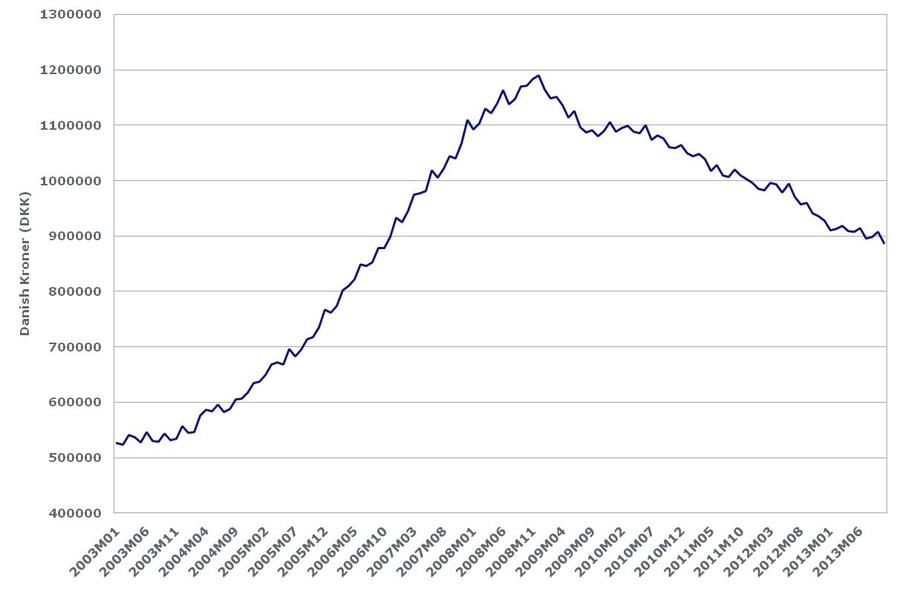
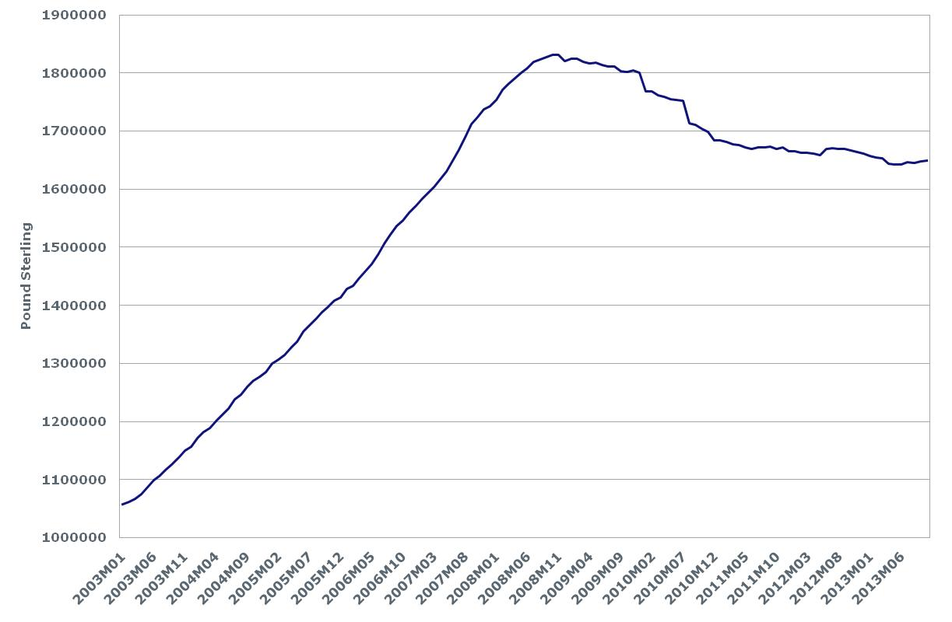
Jesper Berg
Member of Executive Board – Nykredit Bank
Regulatory Affairs and Rating
Christian Sinding Bentzen
Senior Analyst
Regulatory Affairs and Rating
The performance of the Danish and the UK system
Affordability
Outstanding loans and total issuance of covered bonds
Resilience towards falling house prices
Government intervention
Robustness during and after finansiel stress
Total issuance of UK and DK covered bonds
Outstanding loans from DK banks to households and non-financial corporations
Outstanding loans from UK MFIs to households and non-financial corporations
Source: ECBC, the Danish Central Bank and Bank og England

Slide 16
Jesper Berg
Member of Executive Board – Nykredit Bank
Regulatory Affairs and Rating
Christian Sinding Bentzen
Senior Analyst
Regulatory Affairs and Rating
The performance of the Danish and the UK system
Affordability
Outstanding loans and total issuance of covered bonds
Resilience towards falling house prices
Government intervention
Robustness during and after finansiel stress
Source: Michael Lea and own research.

Slide 17
Jesper Berg
Member of Executive Board – Nykredit Bank
Regulatory Affairs and Rating
Christian Sinding Bentzen
Senior Analyst
Regulatory Affairs and Rating
The Danish and the UK system in a financial accounts perspective
Overall balances
The MFI Sector
Insurance corps. and pension funds
Financial balance sheets
Note: data as of end-2013
Source: ECB

Slide 18
Jesper Berg
Member of Executive Board – Nykredit Bank
Regulatory Affairs and Rating
Christian Sinding Bentzen
Senior Analyst
Regulatory Affairs and Rating
The Danish and the UK system in a financial accounts perspective
Overall balances
The MFI Sector
Insurance corps. and pension funds
Insurance corps. and pension funds
The MFI sector
Note: data as of end-2013
Source: ECB

Slide 19

Jesper Berg
Member of Executive Board – Nykredit Bank
Regulatory Affairs and Rating
Christian Sinding Bentzen
Senior Analyst
Regulatory Affairs and Rating
Challenges in Denmark
International regulatory and rating standards
  Add liquidity risks
Popularity and design of adjustable rate mortgages and IO mortgages
Banks as investors

Slide 20
Jesper Berg
Member of Executive Board – Nykredit Bank
Regulatory Affairs and Rating
Christian Sinding Bentzen
Senior Analyst
Regulatory Affairs and Rating
Conclusions
Why did the Vickers Committee not address the issue of mortgages in relation to structural separation and why does the UK covered bond review allow for structural subordination of guaranteed deposits? The Danish model has shown that structural separation in this area is actually possible.
In the UK model more risks remain in the intermediary than in the Danish model, where the more transparent elements are outsourced to investors. Furthermore, the Danish model contains safety valves in relation to the credit risks kept on the balance sheet of the intermediary.
The UK model proved more fragile during the financial crisis than the Danish model.
The UK financial structure and the Danish financial structure are both examples of a hybrid structure that falls between the pure banking model of Southern and Central Europe and the US Capital Markets based model.
While the Danish system have performed well during the financial crisis, it is challenged on many fronts, not least international regulatory and rating standards that are designed for a universal banking model.
The optimal design of mortgage systems on the one hand depends on the characteristics of the particular country, and on the other hand should also raise questions as to whether there is scope for changes, e.g. to other elements of the financial system, that could allow for not only a better mortgage system, but also improvements in other areas.

Slide 21

Jesper Berg
Member of Executive Board – Nykredit Bank
Regulatory Affairs and Rating
Christian Sinding Bentzen
Senior Analyst
Regulatory Affairs and Rating
Post Script

