Slide 1

The Future of Housing Finance:
NIESR/ERSC/CFM Finance Conference
Friday, September 12, 2014
Structure of Securitization Markets:
Role in U.S. Housing Bubble
Susan M. Wachter
Albert Sussman Professor
Professor of Real Estate and Finance

Slide 2
Structure of securitization: role in the US bubble
Securitization and the originate to distribute model: The Dodd-Frank theory of the bubble
Securitization neither necessary nor sufficient for a house price bubble
Financial accelerator/incomplete markets
Shift in structure of securitization market in US: outcomes
Implications for housing finance reform in the US

Slide 3
Housing stability, systemic risk and securitization
International house price boom-bust
Securitization played no consistent role
Implication of the banking/financial system necessary
Securitization market in the US is broken

Slide 4
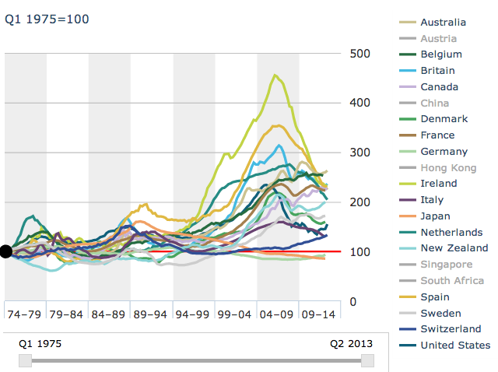
In US and Europe, housing prices peaked in 2007
Sources: BIS; Bundesbank; FHFA; Japan Real Estate Institute; NVM; Nationwide; OECD; Office for National Statistics; Standard & Poor's; Statistics Denmark; Statistics Netherlands; Statistics Sweden; Thomson Reuters; vdpResearch

Slide 5
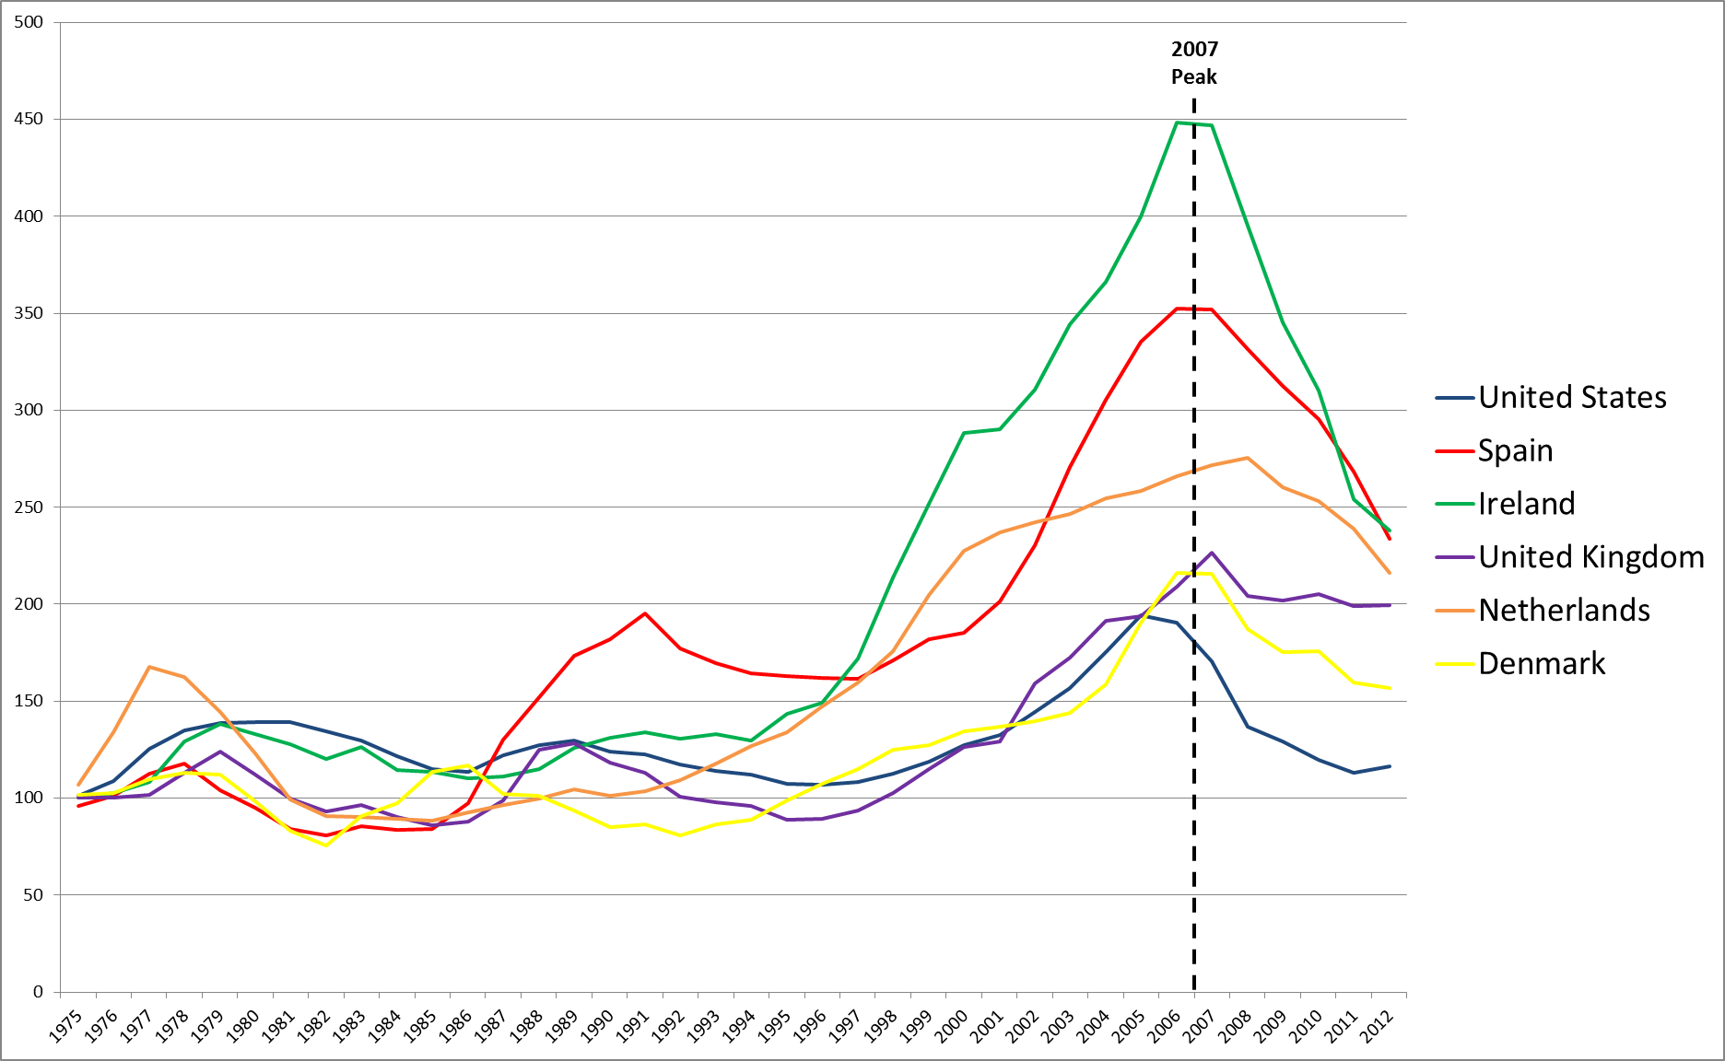
US and Europe bubble economies
Source: OECD, FHFA

Slide 6
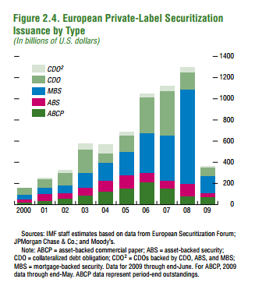
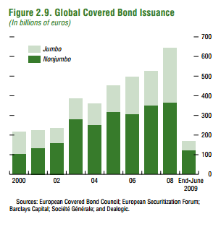
Securitization 2003-2008

Slide 7
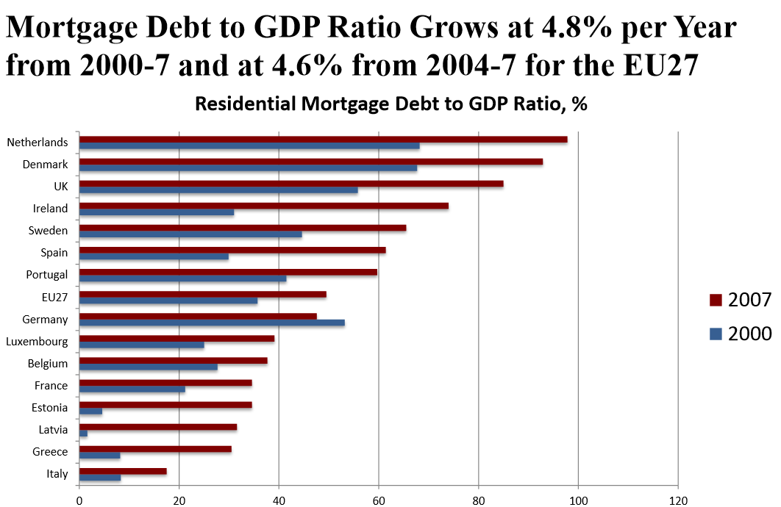

Slide 8
Lending drives real estate prices
Herring, Richard J., and Susan Wachter. Real estate booms and banking busts: an international perspective. US-Japan Management Studies Center, Wharton School of the University of Pennsylvania, 1998.
Notes:
3
Banking crises may occur without real estate cycles and real estate cycles may occur without banking crises, but often linked. Initial impetus may be an increase in demand due to --e.g. a switch to a service economy, opening to foreign investment or accelerate growth.
1.Real estate markets are especially vulnerable to waves of optimism
-Difficult to sell short
-Supply is relatively fixed in s.r. (2-6yrs for new construction)
2. Role of optimists is enhanced to the extent they can obtain financing. As prices increase, they can borrow against capital gains.
3. ↑ financing → ↑ demand → ↑ prices which may encourage still more real estate lending.
Higher p → (1) Bank capital ↑ to the extent the bank holds real estate; (2) Collateral ↑ in value → risk of loss on existing portfolio ↓. Thus can lend more without increasing the risk of insolvency.
Supervisors often regard real estate as especially good collateral --an example of the fallacy of misplaced concretion -- or more often misplaced concrete.
Indeed real estate exposure expands: (1)To entities investing in real estate; (2)To entities using real estate as collateral.
Note works in reverse. When P ↓ →bank cap ↓ & ↑in perceived risk of RE lending. Supervisors may ↑ cap. Requirements & demand provisions.

Slide 9
Securitization and the “American Mortgage”
GSE dominance of the mortgage origination market contributed to a traditional long-term fixed-rate mortgage, the “American Mortgage”
For most of their history, GSEs controlled the lending terms in the mortgage origination market
Their market power allowed them to dictate terms and maintain underwriting standards
GSEs monitored default risk, banks had no choice but to abide—only two conventional securitizers

Slide 10
Externalities and information failure
Borrowers do not internalize feedbacks effects of debt accumulation and asset prices increase on credit booms and busts (Jeanne and Korinek 2011)
Financial amplification mechanism because price of collateral does not reflect endogenous risk.

Slide 11
Prior to mid-2000s: structure of the secondary market
GSEs had “monopoly” on secondary market
Originators abided by GSE standards
If not, originators lost access to secondary market
Average cost pricing for risk, the credit default spread, and put-backs incentivized

Slide 12
Private label securitizers and increasing systemic risk, 2003-7
Private label securitizers entered the secondary mortgage market in force.
PLS resulted in a shift in the structure of the mortgage origination market.
Competition ended oversight resulting in a decline in underwriting
The extent of the decline and product mix shifts were shrouded lending

Slide 13
The GSEs as gatekeepers
GSEs enforced strict guidelines for conforming mortgage they would securitize. If originators did not comply, they would find themselves without a secondary market for their mortgages (Simkovic 2013).
With GSEs as gatekeepers, securitization accompanied by close monitoring of the risks of standardized individual loans.
Market dominated by traditional long-term, fixed-rate mortgages. Average borrower characteristics—high FICO scores, low CLTV ratios, full documentation—indicated that originators were upholding prudent underwriting standards.

Slide 14
PLS and the relaxation of underwriting
PLS issuers willing to purchase riskier loans, growing in capacity in mid 2000s, giving originators access to capital.
PLS issuers did not exercise same due diligence as GSEs did.
Securitizers engaged in a “race to the bottom” with little power over originators as they competed for market share.
PLS pools dominated by non-conforming loans with risky features issued to risky borrowers.

Slide 15
Credit supply in incomplete housing market generates systemic risk
Static component: NTM mortgage riskier than perceived but takes time to be revealed: depends on negative income or price shocks and no possibility for pessimist to short sell
Dynamic component: new products increase demand and drive price up>increase supply of collateral-based credit>increase prices as short term inelasticity in supply of new construction.

Slide 16
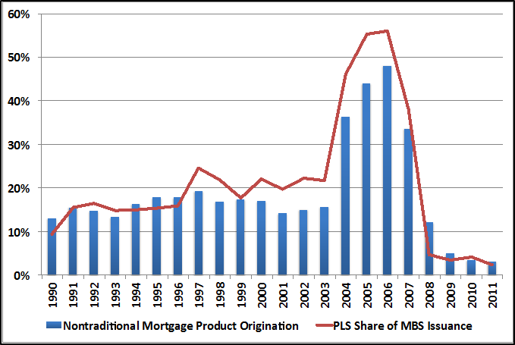
Market Share of Nontraditional Mortgage Products and Private Label Securitization

Slide 17
MBS Issuance Since 2000

Slide 18
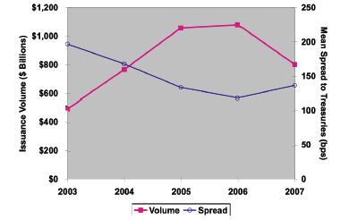
PLS issuance and weighted average PLS spreads

Slide 19
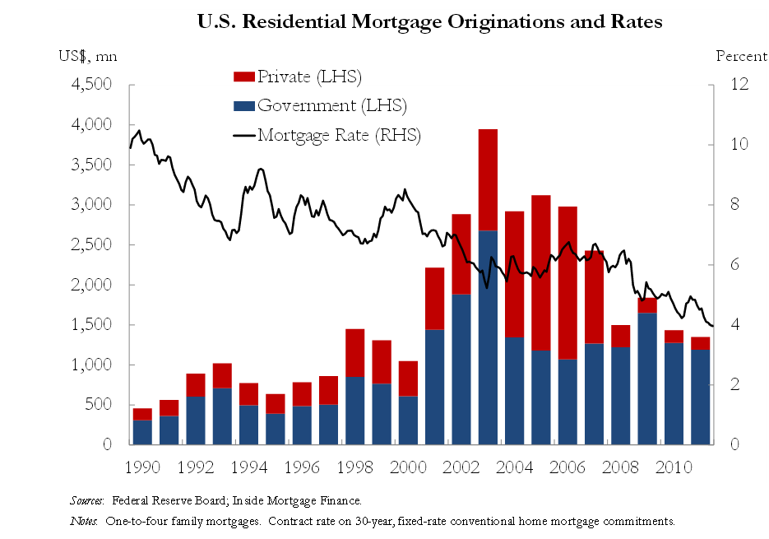
$1 trillion to $0
Source: MBA, Datastream, DB Global Markets Research
http://online.wsj.com/public/resources/documents/WilsonCenter5.22.12.BlueprintforHousingFinanceReform.pdf

Slide 20
Changes in bubble years 2003-7
Mortgage debt
  Prime → subprime, credit score decline
  Fixed-rate → adjustable-rate
  Traditional → nontraditional products, Alt –A, balloons, interest only, option ARMs
  Underwriting → missing, unverified, wrong information
Mortgage securitization structure changed
  Majority GSE-issued → majority private-label
  Simple pass-through → tranched structure
  Standards set by GSEs → securitizers compete for risk

Slide 21
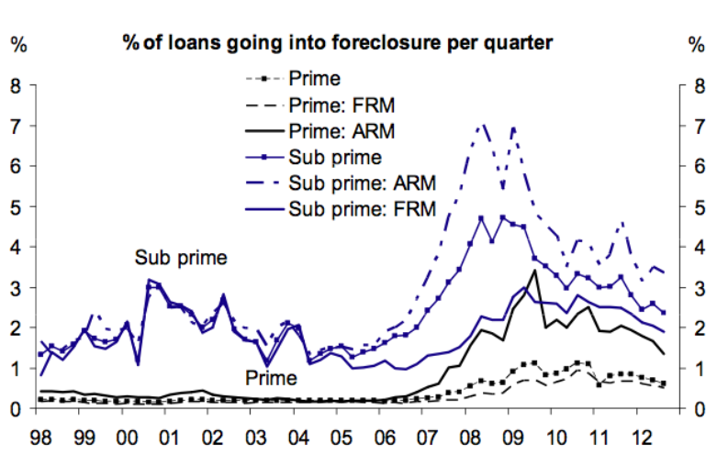
Foreclosure by Market Segment
Source: MBA, Datastream, DB Global Markets Research.

Slide 22
Securitization and housing finance: what’s next?
GSEs now in federal conservatorship
Dodd-Frank foci on originate-to-distribute model and product mix
Consensus on need to bring in private capital—but how?
  Johnson-Crapo fails
  Potential role for securitization as a solution

Slide 23
Thank you
Susan M. Wachter
Sussman Professor
Professor of Real Estate and Finance
Co-Director – Penn Institute for Urban Research
The Wharton School, University of Pennsylvania
Tel: 215-898-6355
Cell: 610-299-9714
wachter@wharton.upenn.edu

Slide 24


