Slide 1
The Future of Housing Finance
Professor David Miles
NIESR Conference
September 2014

Slide 2
Instantaneous real forward rates 10 years ahead
Source: Bank of England. Estimates derived from index-linked gilts.

Slide 3
Population density and density forecasts (medium variants)
Sources: Liesner (1989), Mitchell (2007), United Nations, Word Bank, Bank of England calculations.
Note: Pre-1950 figures are estimates based on population figures from Liesner (1989), Mitchell (2007) and land data from the World Bank for 2000. Data from 2010 are United Nations’ medium population variants.

Slide 4
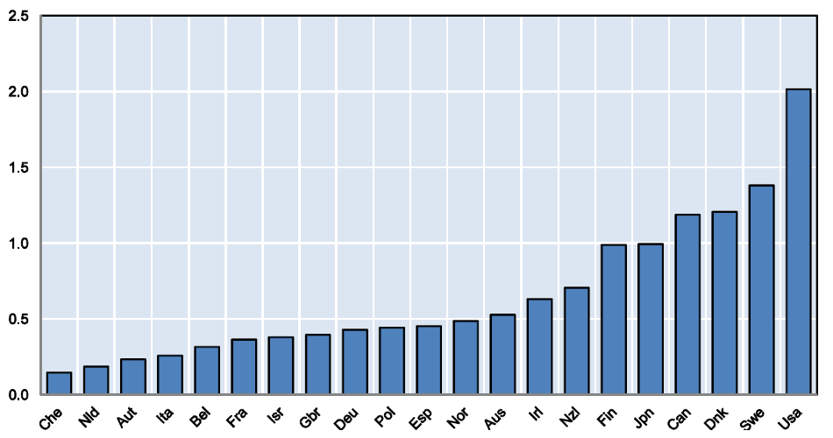
International estimates of the long-run elasticity of new housing supply
Source: OECD estimates, Andrews, Caldera Sánchez and Johansson (2011).
Note: Estimates of the long-run price elasticity of new housing supply where new supply is measured by residential investments. All elasticities are significant at least at the 10% level. In the case of Spain, restricting the sample to the period 1995-2007, which would reflect recent developments in housing markets (such as the large stock of unsold houses resulting from the construction boom starting in 2000 and peaking in 2007-09), only slightly increases the estimate of the elasticity of housing supply from 0.45 to 0.58. Estimation period early 1980s to mid 2000s.

Slide 5
Real house prices (index, 1971 Q1=100)
Source: OECD.

Slide 6
House price to income ratio (index, 1980 Q1=100)
Source: OECD.

Slide 7
Conclusions
High leverage is at the heart of problems in housing market.
Monetary policy and macro prudential policy can influence leverage.
But more fundamentally outside equity might be a way of permanently bringing down reliance upon debt financing.
Switching 20% of funding from debt to outside equity very substantially reduces leverage.
The moral hazard at that scale of outside equity funding might be low enough to make such contracts feasible. But this is a major issue.
Notes:
7

