Slide 1
Performance Pay, Wellbeing and Health
Colin Green
Department of Economics
Lancaster University
c.p.green@lancs.ac.uk

Slide 2
Introduction
Large (economics) literature on performance pay
Main focus on how performance pay solves agency problems
For instance firm owners are profit maximisers, while worker utility is a positive function of pay and negative function of effort
Intuition is that payment on output better aligns worker and firm objectives
PRP can take many forms but basic models consider contemporaneous output based pay (i.e. piece rates, commissions etc)
Classic work is Lazear’s 2000 AER paper on Safelite window replacements
Switch to piece rates leads to large increase in worker productivity
Little increase in direct labour costs.

Slide 3
When Good Contracts Go Bad
At the same time development of literature focusing on ‘perverse’ behaviour under performance pay.
Gaming, Multi-tasking etc.
Why?
1. Useful to think about potential limitations to use of performance pay
2. Importance of careful contract design
3. Empirical literature often focuses on whether performance pay increases productivity – but forgets about firm’s objective, i.e. profits.
- famously Freeman and Kleiner, 2005 IR paper shows how a firm can switch from piece rates to time rates, productivity can go down, but profits rise

Slide 4
How Do PRP Contracts Change Behaviour?
2 ways (not mutually exclusive)
The standard piece rate model is about effort
Workers respond to output based incentives by working ‘harder’
Actually in terms of labour supply it is not clear what ‘harder’ means – i.e. at the intensive margin (less shirking) or extensive margin (longer hours)
Change decision making to be more aligned with firms.
Paying bonuses to traders isn’t about working harder – but incentivising ‘correct’ decision making.
Company owners are risk neutral – worker is risk averse so will not take the right ‘risks’
Payment on performance incentivises them to maximise expected returns from investments
In both dimensions sorting is also important - PRP seeks to attract more productivity, more risk taking workers.

Slide 5
How Piece Rates Incentivise Effort
Contrast effort choice on salary (w=salary) with minimum output requirement
piece rate output/effort, wage choice (conditional on participation – piece rate increases effort and wages)
So performance pay allows for higher effort (output) – pay combinations
£
U¹
w=-s+bQ
U⁰
w*
salary
q,e
_{q0}
q*

Slide 6
Does PRP Change Behaviour?
Easiest to look at labour supply response at margin of hours worked
Dependent Variable – total hours worked (inc Overtime)
British Household Panel Survey (BHPS) 1997 - 2008
 | (I) | (II) | (III)
Individual PRP | 1.751*** | 0.378*** | 0.253**
 | (0.120) | (0.103) | (0.0990)
Bonus/Profit Share | 1.144*** | 0.471*** | 0.206**
 | (0.0942) | (0.0834) | (0.0818)
Constant | 45.47*** | 42.49*** | 41.25***
 | (0.509) | (0.570) | (0.623)
Worker Fixed Effects |  | X
‘Match’ Fixed Effects |  |  | X
Observations | 76,042 | 76,042 | 76,042
R-squared | 0.247 | 0.064 | 0.040
Number of pid |  | 18,981
Number of match id |  |  | 28,892
Demonstrates that on average PRP jobs are associated with longer hours
The ‘within worker’ effect. A given worker exposed to PRP works harder (but note smaller magnitude)
The ‘within worker-job’ effect. A worker doing a specific job works harder under PRP.
(difference between II & III suggests that shifts from PRP involve some change in ‘jobs’)
Harder to find credible evidence on intensive effort / risk taking
Standard errors in parentheses
*** p<0.01, ** p<0.05, * p<0.1
All regressions include occupation, industry, education, pay, year and region controls.

Slide 7
And Pay is higher
No lack of evidence that worker’s are rewarded for taking PRP contracts (see for instance Daniel Parent’s work with various co-authors in US)
For UK – less evidence but for instance effect of performance pay on log hourly earnings:
 | BHPS 1997-2008
 | (I) | (II) | (III)
PRP | 0.183*** | 0.0616*** | 0.0267***
 | (0.00853) | (0.00775) | (0.00764)
Bonus/Profit Share | 0.171*** | 0.0524*** | 0.0152**
 | (0.00670) | (0.00625) | (0.00631)
Constant | 2.614*** | 2.510*** | 2.616***
 | (0.0350) | (0.0414) | (0.0465)
Worker Fixed Effects |  | X
Match Fixed Effects |  |  | X
Observations | 76,131 | 76,131 | 76,131
R-squared | 0.375 | 0.164 | 0.109
Number of pid |  | 19,016
Number of matchid |  |  | 28,943
Large ‘raw’ premium
Much of this is sorting
Even more from the type of job
But still premiums associated with this pay (and bonus/profit share may miss larger periodic payments)
Standard errors in parentheses
*** p<0.01, ** p<0.05, * p<0.1
All regressions include occupation, industry, education, pay, year and region controls.

Slide 8
What Happens at the Margin? Intrinsic Motivation and Wellbeing
Does this entirely describe the trade-off?
i.e. workers who choose PRP do so as it allows them to trade-off hours/effort for more pay?
Put another way, is there ‘movement’ at any other margin?
A range of research has considered whether PRP comes at further costs to the worker in the form of:
1. Job satisfaction and wellbeing
Health
‘Time-Squeeze’ on other private activities, including leisure, family and activity that may foster social capital
Remainder of this talk will focus on these issues (BTW answer is (1)No, (2)Yes, and (3) not sure)

Slide 9
What Happens at the Margin? Intrinsic Motivation and Wellbeing
A standard complaint in the Industrial Relations literature is that PRP ‘crowds out’ intrinsic motivation.
It robs workers of the warm glow from doing a good job.
Transforms interaction between firm and worker into a cold market transaction.
No one way to test this – but satisfaction with the job seems as good as any:
Q: Does moving on to performance pay reduce job satisfaction?
Again look at BHPS…

Slide 10
What Happens at the Margin? Intrinsic Motivation and Wellbeing
A standard complaint in the Industrial Relations literature is that PRP ‘crowds out’ intrinsic motivation.
It robs workers of the warm glow from doing a good job. Transforms this into a cold market transaction.
No one way to test this – but satisfaction with the job seems as good as any:
Q: Does moving on to performance pay reduce job satisfaction?
Again look at BHPS…

Slide 11
Intrinsic Motivation and Performance pay
(originally looked at in Green and Heywood, 2008 – Economica) here with updated data
BHPS 1998-2008.
 | (1) | (2) | (3) | (4)
VARIABLES |  |  | Exclude bonuses<£1,000 p.a. | Bonuses Quartiles
PRP | -0.0292** | 0.0298** | 0.0431** | 0.0254*
 | (0.0130) | (0.0146) | (0.0175) | (0.0153)
Bonus/Profit Share | 0.0829*** | 0.00566 | 0.0431**
 | (0.0102) | (0.0116) | (0.0195)
Bonus (quart 1) |  |  |  | 0.00138
 |  |  |  | (0.0193)
Bonus (quart 2) |  |  |  | -0.00657
 |  |  |  | (0.0190)
Bonus (quart 3) |  |  |  | -0.0213
 |  |  |  | (0.0194)
Bonus (quart 4) |  |  |  | 0.0357
 |  |  |  | (0.0239)
Worker FE |  | X | X | X
Constant | 6.472*** | 5.508*** | 5.488*** | 5.536***
 | (0.0670) | (0.0754) | (0.0862) | (0.0783)
Observations | 88,170 | 88,170 | 72,518 | 84,513
R-squared | 0.030 | 0.007 | 0.007 | 0.008
Number of pid |  | 20,986 | 19,540 | 20,465
No robust negative effect – in fact PRP associated with higher job satisfaction
Some evidence that large bonuses are associated with more job satisfaction
Perhaps this misses the point?
Maybe PRP comes at the cost of lower satisfaction in life more generally?

Slide 12
Intrinsic Motivation and Performance pay
Life-satisfaction (happiness) and performance pay
 | (1) | (2) | (3) | (4)
 | OLS | FE | exclude small bonuses | bonus quartiles
PRP | 0.0210* | 0.00894 | 0.0147 | 0.00929
 | (0.0124) | (0.0122) | (0.0148) | (0.0128)
Bonus/Profit Share | 0.0483*** | 0.0101 | 0.0356**
 | (0.00977) | (0.00987) | (0.0165)
Bonus (quart 1) |  |  |  | 0.0112
 |  |  |  | (0.0168)
Bonus (quart 2) |  |  |  | 0.00435
 |  |  |  | (0.0159)
Bonus (quart 3) |  |  |  | -0.00151
 |  |  |  | (0.0160)
Bonus (quart 4) |  |  |  | 0.0337*
 |  |  |  | (0.0197)
Constant | 6.574*** | 5.508*** | 5.497*** | 5.452***
 | (0.0665) | (0.0661) | (0.0770) | (0.0693)
Observations | 73,798 | 73,798 | 60,516 | 71,129
R-squared | 0.024 | 0.005 | 0.005 | 0.005
Number of pid |  | 19,082 | 17,663 | 18,958
Again – if anything PRP and bonuses (esp. big ones) make you happier!
(And note this is holding earnings constant!)

Slide 13
Performance pay and health
If PRP leads to worker’s increasing effort or taking behaviour – could this be bad for workers in the long run?
“Workmen. . . when they are liberally paid by the piece, are very apt to
overwork themselves, and to ruin their health and constitution in a few
years (Smith 1776, p. 83).”
A small body of research has developed demonstrating a link between performance pay and health.
This link is important as part of the wage premium may be a risk premium…. And also matters who foots the health bill (employers, the worker or the state) – i.e. is there a potential for moral hazard?
Two versions of this:
contemporaneous effect – accidents/injuries through extra effort, poor maintenance of equipment etc
- Relatively straightforward to test
- Bender, Green and Heywood (2011) J.PopEcon one study that looks at cross-European evidence on health effects of working in PRP

Slide 14
Manual Workers and Injuries
Cross European Evidence
(Large) Increase in workplace injury due to piece rates
Concentrated in manual work
These effects survive detailed controls for workplace hazards and relatively detailed controls for effort
(in fact controlling for effort does not change piece rate effect at all)
So a slight puzzle re: transmission mechanism
Can conduct similar exercise for UK on PRP…
Payment Methods and Probability of Workplace Injury, Probit Marginal Effects, EWCS 2000 & 2005.
 | All | Manual Workers | Non-Manual Workers
Piece Rate | 0.052* [0.009] | 0.067* [0.017] | 0.014** [0.008]
Profit Share | -0.024* [0.007] | -0.014 [0.021] | -0.009 [0.008]
Group Bonus | 0.019 [0.022] | 0.079 [0.057] | 0.007 [0.010]
Share Payment | -0.016 [0.014] | 0.010 [0.044] | -0.013 [0.010]
Male | 0.060* [0.004] | 0.070* [0.011] | 0.012** [0.005]
Age | 0.0005 [0.002] | 0.001 [0.003] | 0.001 [0.001]
Age Sqr * 10 | -0.0001 [0.0002] | -0.0002 [0.0004] | -0.00018 [0.00013]
Pseudo r² | 0.056 | 0.039 | 0.037
Observations | 33,501 | 12,860 | 20,641

Slide 15
PRP and Self-Assessed Health
BHPS, Performance Pay and Self-Assessed Health (1 = excellent,…,5 very poor)
 | (1) | (2) | (3) | (4) | (5)
 | OLS | Worker FE | Match FE | exclude small bonuses | bonus quartiles
PRP | -0.0335*** | -0.00848 | -0.0142 | -0.0103 | -0.00743
 | (0.00911) | (0.00931) | (0.0103) | (0.0112) | (0.00978)
Bonus (quart 1) |  |  |  |  | -0.000958
 |  |  |  |  | (0.0127)
Bonus (quart 2) |  |  |  |  | -0.00406
 |  |  |  |  | (0.0120)
Bonus (quart 3) |  |  |  |  | -0.00466
 |  |  |  |  | (0.0121)
Bonus (quart 4) |  |  |  |  | 0.00174
 |  |  |  |  | (0.0147)
Bonus/Profit Share | -0.0309*** | -5.54e-05 | -0.0115 | -0.00262
 | (0.00711) | (0.00740) | (0.00844) | (0.0123)
Constant | 1.790*** | 1.795*** | 1.867*** | 1.884*** | 1.836***
 | (0.0785) | (0.0754) | (0.0911) | (0.0670) | (0.0779)
Observations | 75,438 | 75,438 | 75,438 | 62,121 | 72,793
R-squared | 0.021 | 0.004 | 0.005 | 0.004 | 0.004
Number of pid |  | 19,202 |  | 17,788 | 19,086
Number of matchid |  |  | 29,235
Standard errors in parentheses
*** p<0.01, ** p<0.05, * p<0.1

Slide 16
Performance pay and stress…
No effect – but perhaps this misses long term effects of PRP on health, for instance due to overwork/stress/reduction in healthy behaviours.
Naturally harder to test
Bender and Theodossiou (OEP, forthcoming) is one attempt.
BHPS
Looks at relationship between exposure to PRP and likelihood of ‘exiting’ good health.
In essence takes workers in an initial period in good health and compares ‘survival’ in good health of those on PRP to those not.

Slide 17
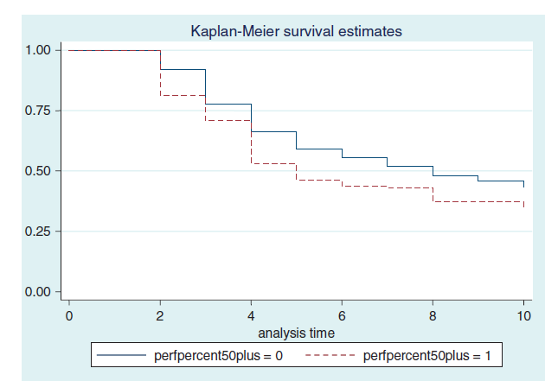
PRP Exposure and long term health (Bender and Theodossiou)
‘Survival’ in good health over years
Conditional on exposure to PRP
Markedly lower survival rate

Slide 18
PRP and Health
This (and other papers, Artz and Heywood ) – lead to a picture of a negative health effect of PRP .
If understood by workers means that part of the wage premium needs to be viewed in a compensating wage differential light.
But little known about transmission mechanism…

Slide 19
PRP at the Margin
PRP works by increasing the private return to increased effort.
A natural question is to ask is does this ‘squeeze out’ other activities.
If, so what types of activities. Is there a market failure dimension?
One concern is that it influences the provision of goods with a social value. For instance:
PRP works best on high ability individuals – these may be those who have high social value in other activities (charities, organisations etc)
Increased work may influence other outcomes that have social consequences – family stability?
A reduction in leisure time that my be best ‘co-consumed’
Little work on this...
1st question – does PRP influence leisure outcomes of individuals – lack of information in most data sets.

Slide 20
Effect on Leisure
Satisfaction with Amount of Leisure? BHPS 1998-2008
Some evidence that PRP reduces ‘satisfaction with leisure amount’
Might indicate greater time pressure for individuals on PRP
Is there any evidence of what else might be reduced at the margin?
 | (1) | (2) | (3) | (4) | (5)
 | OLS | FE | match | exclude small bonuses | bonus quartiles
 |  |  |  | FE | FE
PRP | -0.0337** | -0.0279* | -0.0176 | -0.0167 | -0.0194
 | (0.0162) | (0.0161) | (0.0175) | (0.0194) | (0.0169)
Bonus (quart 1) |  |  |  |  | 0.0264
 |  |  |  |  | (0.0222)
Bonus (quart 2) |  |  |  |  | -0.00261
 |  |  |  |  | (0.0210)
Bonus (quart 3) |  |  |  |  | -0.0321
 |  |  |  |  | (0.0211)
Bonus (quart 4) |  |  |  |  | -0.0494*
 |  |  |  |  | (0.0260)
Bonus/Profit Share | 0.0150 | -0.0111 | 0.00223 | -0.0105
 | (0.0128) | (0.0130) | (0.0145) | (0.0216)
Constant | 6.084*** | 4.985*** | 4.779*** | 4.694*** | 4.668***
 | (0.0906) | (0.110) | (0.112) | (0.104) | (0.0943)
Observations | 73,945 | 73,945 | 73,945 | 60,645 | 71,269
R-squared | 0.037 | 0.009 | 0.009 | 0.010 | 0.009
Number of pid |  | 19,094 |  | 17,674 | 18,967
Number of matchid |  |  | 29,097
Standard errors in parentheses *** p<0.01, ** p<0.05, * p<0.1

Slide 21
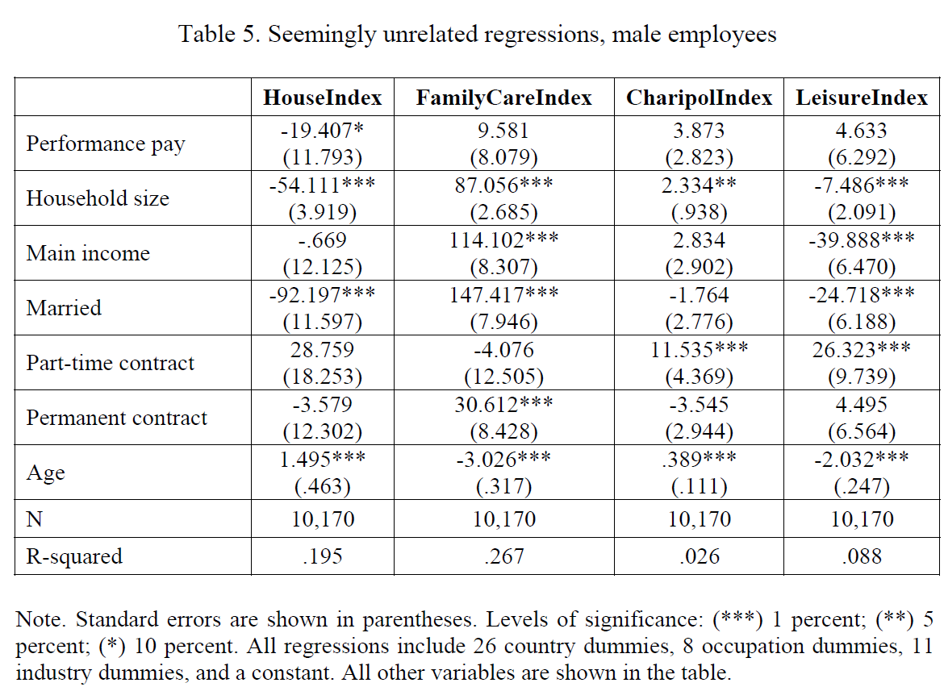
PRP and Outside Activities
Cross-European evidence
Appears that PRP comes solely at the expense of housework
(no effect for women)
But no effect on child care, charitable activity or leisure.
(unreported BHPS estimates suggest no effect on involvement with charities.)
Standard errors in parentheses *** p<0.01, ** p<0.05, * p<0.1

Slide 22
PRP and Marriage Stability
Given the margin that is being substituted away from (housework) does this have implications for marriage.
Consider a group of married, male heads of households
Does PRP affect the likelihood of marriage dissolution?
Preliminary evidence suggests no effect within the next year.
But perhaps an approach as per Bender and Theodossiou is the way forward.

Slide 23
Conclusions
Empirical evidence fits with basic model of how PRP mitigates agency problems.
By tying pay to performance, workers can choose higher effort, wage combinations than available on time rates.
With this said, UK evidence suggests a small return to PRP once worker and job are controlled for.
This return may be even smaller once the potential for poorer health outcomes are accounted for.
Evidence on this is not conclusive, but suggests PRP associated with more injuries in the short term, and worse health in the long term.
Harder to ‘get at’ what margin individuals substitute from towards more work.
More work needed here, but initial research suggests that this substitution may be confined within the household.

