Slide 1
Does Performance Pay Increase Wage Inequality?
Mark Bryan (ISER, University of Essex)
Alex Bryson (NIESR and CEP)
NIESR Workshop 26th June 2014, London
Funded by the ESRC (Grant Ref. ES/i035846/1)

Slide 2
Motivation
Vast literature on wage effects of performance pay (PP)
Expectation that PP should increase wage dispersion
But does it? Depends on
Who receives it
Size of any PP premium/penalty across the distribution
Evidence on contribution to changes in wage dispersion in the United States is contested
Important: Lemieux et al., 2009
Not really: Gittleman and Pierce, 2012
What about Britain today?
Notes:
2

Slide 3
What we do
Incidence of PP 1998-2008
Types of PP
Men, Women, FT women
Who receives PP?
Occupation, industry, demographics
Effects of PP on wage dispersion
Estimate counterfactual wage distribution (as per Lemieux et al., 2009)
Notes:
3

Slide 4
Findings
PP receipt falls for women and is stable for men between 1998 and 2008
True for broad and narrow measures of PP
Robust to controls for demographic and job traits
Positive selection into PP on ability (observed and unobserved)
Thus regression-adjusted wage returns to PP are smaller than raw gap. Remain 10 log points, adjusting for observed traits, and 3 log points, adjusting for unobserved traits.
Wage dispersion grew at the top of the wage distribution (very top for men), and reduced at the bottom of the distribution for women (not men).
PP contributed to growing wage dispersion at the top, but only among women
Robust to PP measure used
Most notable among FT women
Notes:
4

Slide 5
PP Effect on Wage Dispersion
PP raises wage dispersion via worker sorting (Lazear 1986, 2000; Prendergast 1999), and because PP better reflects individual underlying marginal productivity than fixed pay (FP) jobs:
High ability workers able to recover higher wages for that ability in presence of PP
Effect will therefore be enhanced by high incidence of PP at top end of wage distribution (Bell and Van Reenen, 2010)
PP may contribute to growing wage dispersion
Increasing returns to ability (SBTC) -> PP as the mechanism
Growth in bargaining power of high paid (PP) workers
Empirical evidence contested
PP linked to higher wage dispersion across employees in cross-section (Bryson et al., 2014)
But link to growth in wage dispersion is contested
US: Lemieux et al. 2009 v Gittleman and Pierce 2012
Germany: Sommerfeld
Notes:
5

Slide 6
Data
British Household Panel Survey.
Random sample of some 5k households in 1991 (wave 1) design to represent Britain (not inc NI).
All household members aged 16+ interviewed annually until 2008 (wave 18), plus “new” members (e.g. new partners and kids reaching 16 yrs).
Does not reflect A8 immigration.
Most respondents interviewed in Sept/Oct.
Use cross-sectional survey weights throughout.
Look at hourly wage = (usual gross pay / (usual basic hours + 1.5 x usual paid overtime))
Includes regular bonuses, commission etc
Irregular bonuses are collected but issue of how to include (and avoid double counting). Still ongoing…
Notes:
6

Slide 7
PP measures
Two measures of PP collected, but not consistently across all waves, so care needed.
Bonus question:
“Does your pay ever include incentive bonuses or profit related pay?” (waves 1-5)
“In the last 12 months have you received any bonuses such as a Christmas or quarterly bonus, profit-related pay or profit sharing bonus, or an occasional commission?” (waves 6-18)
Performance related pay (PRP) question:
“Does your pay include performance related pay?” (waves 8-18)
As explained below, we focus on waves 8-18, so use questions in bold.
Notes:
7

Slide 8
PP incidence over time – “bonuses”

Slide 9
PP incidence over time – “PRP”

Slide 10
PP trends and correlates
Notwithstanding data discontinuities, it appears that PP incidence has been either stable (men) or trending down slightly (women) over last 15-20 years.
Trends broadly hold up in model controlling for demographic and job characteristics.
PP workers less likely to be women, PT, and temporary, and are paid more than non PP workers. But some differences between the PRP (only) and bonus (only) groups:
PRP workers are more highly educated than bonus workers and earn more.
Over 20% of PRP workers are in public sector; 8% of bonus workers (and correspondingly more PRP workers are unionised).
PRP and bonus are most common among managers and sales occupations; but bonuses also common among clerical and manual occupations.

Slide 11
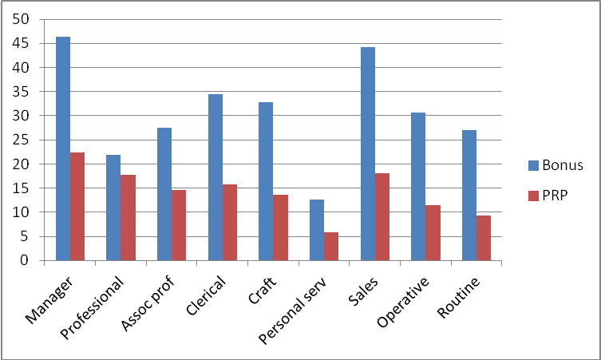
Performance pay by occupation

Slide 12
Broad and narrow measures of PP
Bonus and PRP measures seem to capture different things:
Bonus likely captures more occasional forms of PP, not necessarily related to performance, e.g. Christmas bonus or related to collective performance, e.g. profit-related pay.
PRP asks directly about “performance”
Gittleman and Pierce (2012) used two PP measures, one including all bonuses, the other including performance bonuses only.
In this spirit, we use two alternative measures of PP:
Narrow PP: PRP receipt
Broad PP: PRP or bonus receipt
Implies we can only use data from 1998 onwards (no PRP before then).

Slide 13
PP incidence over time – broad measure of PP

Slide 14
PP and wages
Before looking at wage distribution, check whether there is a PP premium at the mean and how much can be explained by selection of workers into jobs.
Wages of PP workers are on average 11-24% higher than for FP workers. After controlling for personal and job characteristics, premium is 10-11%, and after controlling for unobserved individual traits it is 2-4%.
So on average PP raises wages but there is positive sorting into PP jobs.
 | Raw | Adjusted (OLS) | Adjusted (FE)
Broad PP
Men | 20.4% | 11.3% | 2.9%
Women | 13.0% | 10.0% | 4.1%
Women (FT) | 10.9% | 11.1% | 4.1%
Narrow PP
Men | 21.0% | 9.8% | 2.1%
Women | 23.4% | 9.8% | 3.9%
Women (FT) | 19.1% | 10.3% | 3.5%

Slide 15
Wage dispersion
Look at how hourly wage dispersion has changed over 1998-2008 for 3 groups: men, women and FT women.
We show graphs of dispersion in both tails (1%, 5% and 10% relative to median; note negative scale for lower tail).
Use 2-year moving average to increase sample size (approx 35-40 obs in 1% tails (25 obs for FT women)).
How does BHPS compare with other sources (noting sample differences)?

Slide 16
Wage dispersion over time - men

Slide 17
Wage dispersion over time - women

Slide 18
Wage dispersion over time – FT women

Slide 19
Wage dispersion over time
We compare our results to NES/ASHE trends (90-50 and 50-10) reported in Lindley and Machin (2013).
For women’s hourly wages, L&M find increasing dispersion at top and reducing dispersion at bottom over 1998-2008.
We find similar, though little change at very bottom (50-1, not reported in L&M)
For men’s hourly wages, L&M find increasing dispersion at top and moderately reducing dispersion at bottom over 1998-2008.
We only find increasing dispersion at very top (99-50, not reported in L&M).
At bottom we see no real change except in 50-1 differential (falling until 2001-2, then increasing sharply).
Sample differences? E.g. incomplete ASHE coverage of low paid workers; lack of coverage of new immigrants in BHPS.

Slide 20
Estimating PP Effect on Wage Dispersion
Reweighting estimator
Di Nardo and Lemieux 1997; Lemieux et al 2009
Constructs counterfactual wage distribution that proxies wage distribution that would have obtained in the absence of performance pay
Achieved by reweighting fixed pay employees such that those with a higher PP probability are given a larger weight
Outcome: obtain distribution of FP employees that is representative of whole workforce.
Compare counterfactual distribution (no PP employees) with actual distribution (that includes PP employees).
Hence recover PP effect at different parts of wage distribution:
Show PP effect on cross sectional distributions in 1998-2000 and 2006-08.
Show how actual distribution changed between 1998-2000 and 2006-08; and how it would have changed in absence of PP.
Notes:
20

Slide 21
Effect of PP (broad) on wage distribution – men

Slide 22
Effect of PP (broad) on change in wage distribution – men

Slide 23
Effect of PP (broad) on wage distribution – women

Slide 24
Effect of PP (broad) on change in wage distribution – women

Slide 25
Effect of PP (broad) on wage distribution – FT women

Slide 26
Effect of PP (broad) on change in wage distribution – FT women

Slide 27
Effect of PP on wage dispersion
PP raises overall wages – but by different amounts across distribution
Note this is not the same as PP premium referred to earlier! Here we compare actual world (with PP) vs counterfactual, no PP world. There we compared PP workers vs FP workers.
Men:
PP increases wages by about 5% at median, but by substantially more (up to 10%+) towards top of distribution
Hence PP widens top-half inequality – but widening effect did not change between 1998-2000 and 2006-8.
So overall PP did not contribute to changes in men’s wage inequality over the period.
(FT) women:
PP increases wages by about 2% at median.
Larger effects (up to 4%) in lower half of distribution in 1998-2000, but larger effects in upper half of distribution in 2006-8. So PP became less equalising over the period.
Overall effect of PP was to widen inequality in top half.
The above for broad PP. Preliminary estimations suggest similar results for narrow PP.

Slide 28
Conclusions
PP receipt falls for women and is stable for men between 1998 and 2008
True for broad and narrow measures of PP
Robust to controls for demographic and job traits
Positive selection into PP on ability (observed and unobserved)
Thus regression-adjusted wage returns to PP are smaller than raw gap. Remain 10 log points, adjusting for observed traits, and 3 log points, adjusting for unobserved traits.
Wage dispersion grew at the top of the wage distribution (very top for men), and reduced at the bottom of the distribution for women (not men).
PP contributed to growing wage dispersion at the top, but only among women
Robust to PP measure used
Most notable among FT women
Notes:
28

Slide 29
Next Steps
Add detailed results for narrow PP measure.
Current results based on PP receipt in a given year. Extend to look at PP jobs (receipt in any year in a given job).
But need “end-point adjustment” to correct for limited number of periods observed at each end of panel
We currently include public and private sectors. Do for private sector only? Sample sizes (for PRP workers)?
Include irregular bonuses in hourly wage measure?
Notes:
29

