Slide 1

The UK Productivity Puzzle, 2008-2012: Evidence using Plant Level Estimates of Total Factor Productivity presentation by
Richard Harris
This work contains statistical data from ONS which is Crown copyright and reproduced with the permission of the controller of HMSO and Queen's Printer for Scotland. The use of the ONS statistical data in this work does not imply the endorsement of the ONS in relation to the interpretation or analysis of the statistical data. This work uses research datasets which may not exactly reproduce National Statistics aggregates.

Slide 2
Motivation
Some 6 years after the 2008 banking crisis
  official ONS data shows:
    output-per-worker for the whole economy some 4 per cent below the pre-2008 level, and
    16 per cent lower than if the pre-2007 trend had continued
US, France and Germany, labour productivity has fully recovered
  opening up a ‘productivity gap’ with the UK
Important consequences
  for long-run growth
  for effective operation of monetary and fiscal policy as knowledge of the productive capacity of the economy/‘output gap’ informs:
    decisions relating to the size of the government’s financial deficit
    use of discretionary fiscal and monetary policy to boost/constrain output

Slide 3
Overview
Use ABS plant-level data to look for evidence of
  post-2007 differences in the levels of TFP/LP to consider a ‘compositional effect’ explanation
    across industry and plant size bands (and other relevant sub-groups such as foreign-owned plants)
  the effect on LP of capital/intermediate-inputs deepening and TFP
    To consider a ‘factor-proportions’ (substitution of labour for capital) explanation
    ‘innovation pessimism’ argument
  Whether plant closure declined post-2007
    Leading to ‘zombie firms’ and confirmation of ‘misallocation’ explanation
Misallocation is also considered through:
  a decomposition of TFP productivity growth for 2007-2012

Slide 4
Estimates of TFP
Estimate:
To obtain:
Use system-GMM
  Fixed effects, endogeneity, dynamics

Slide 5
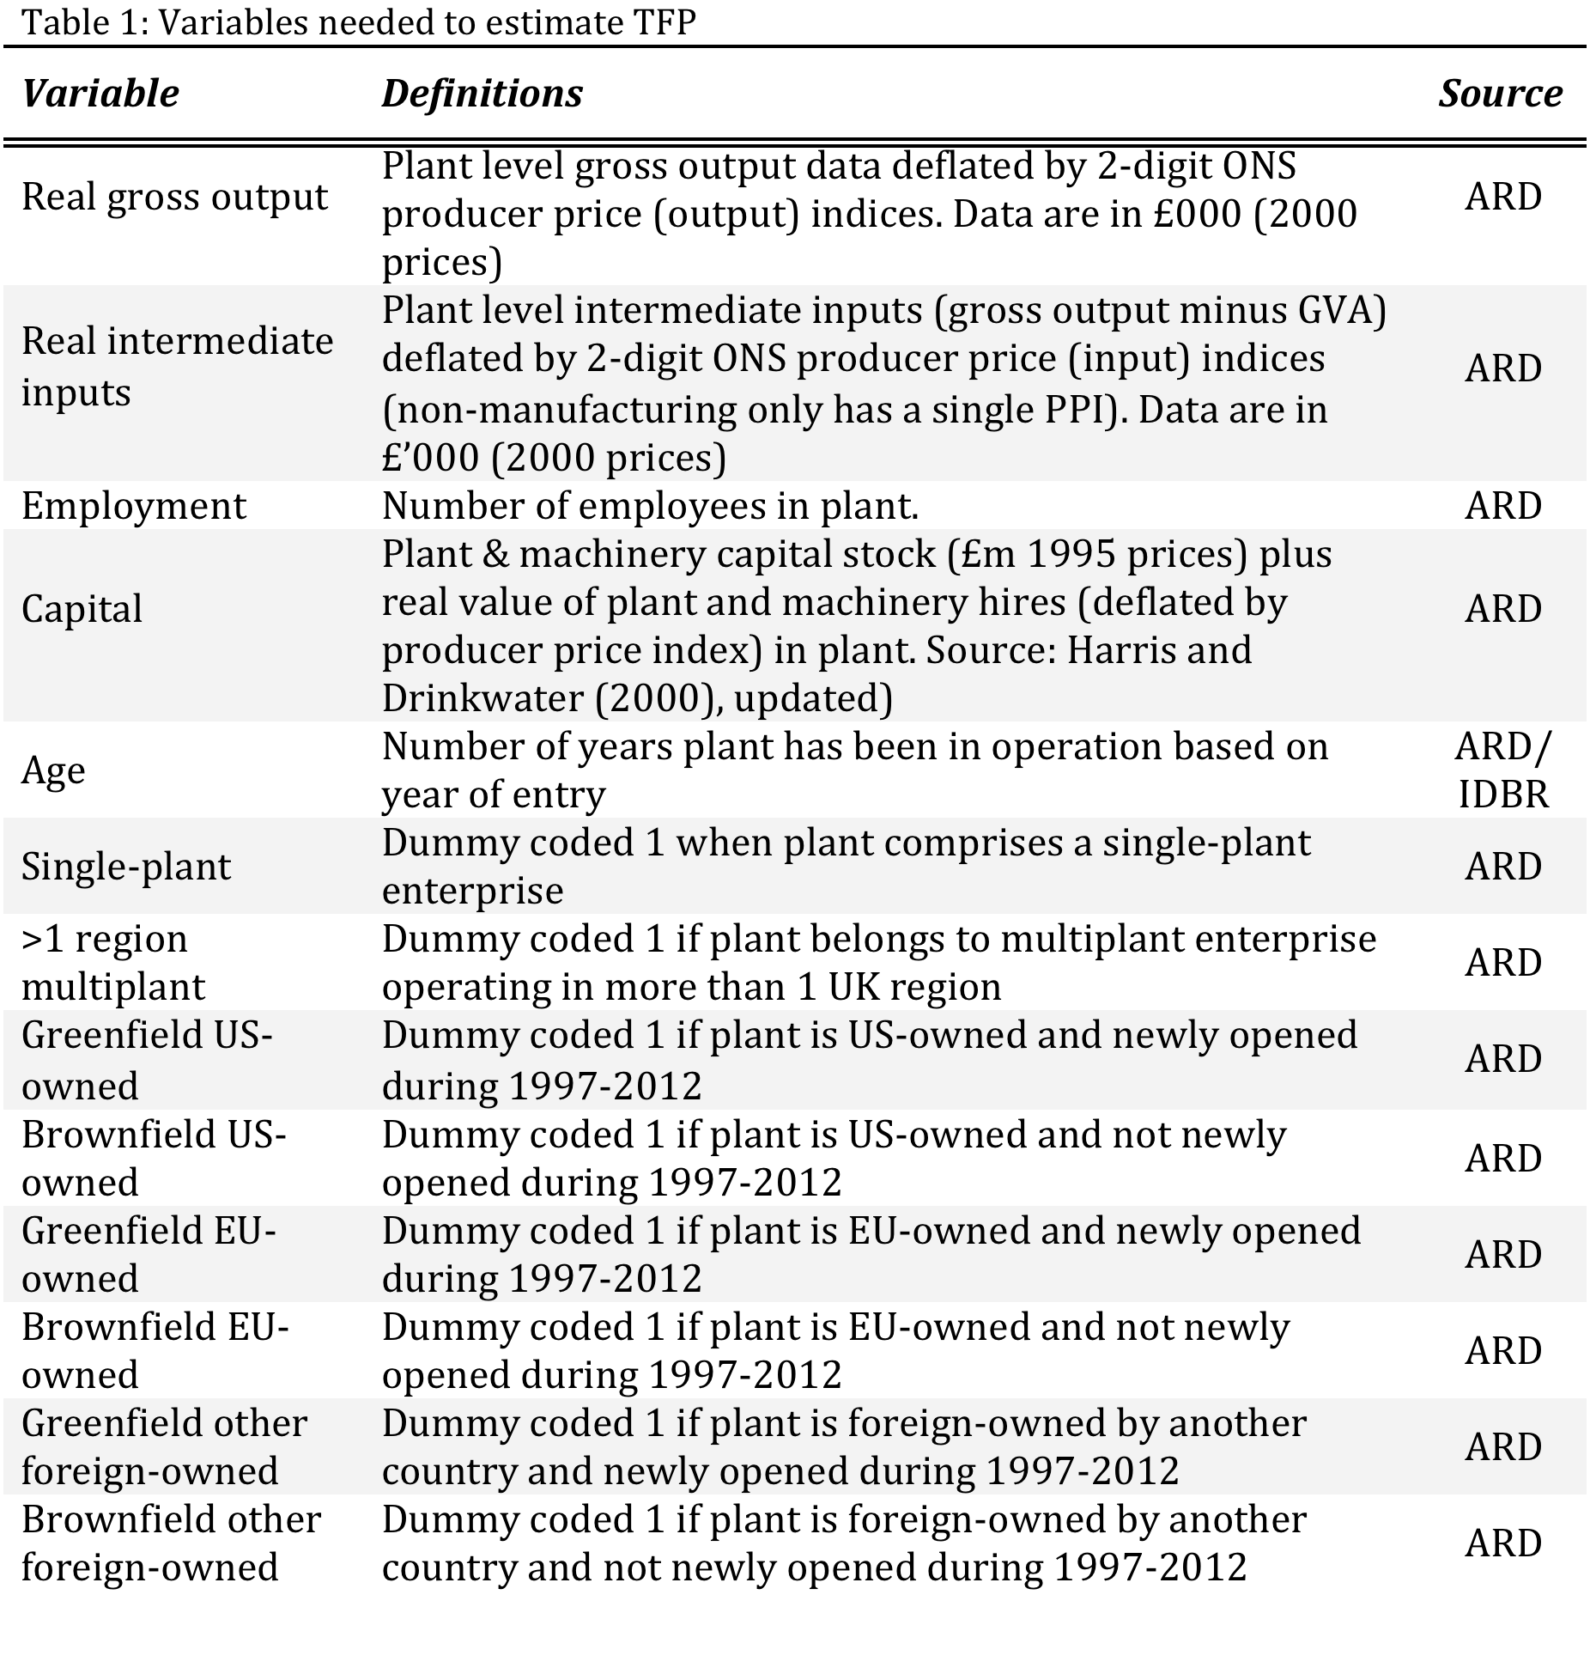

Slide 6
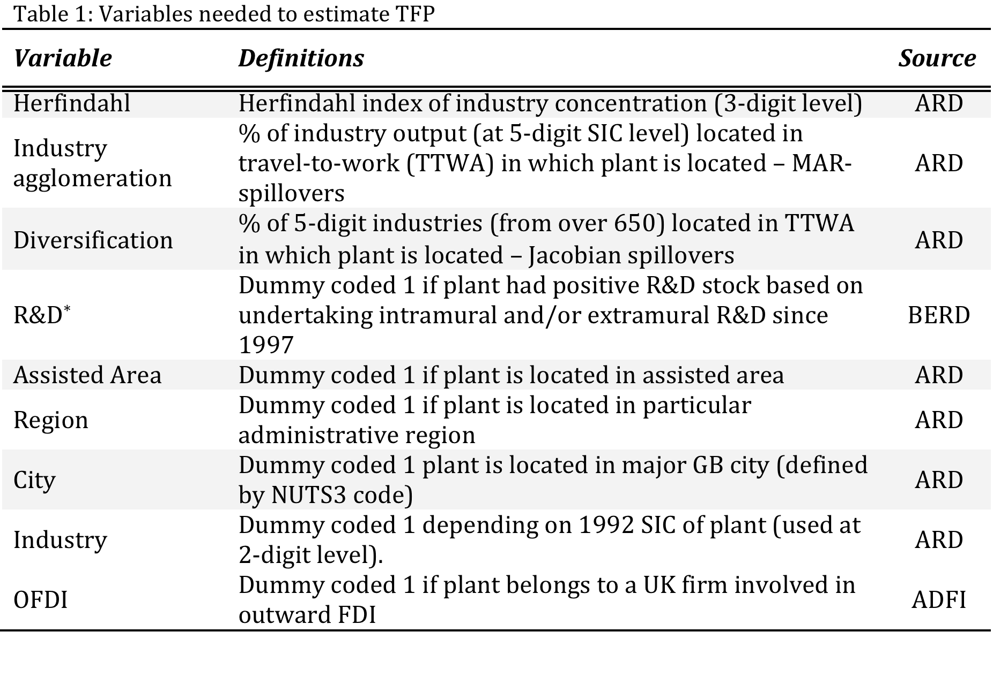

Slide 7
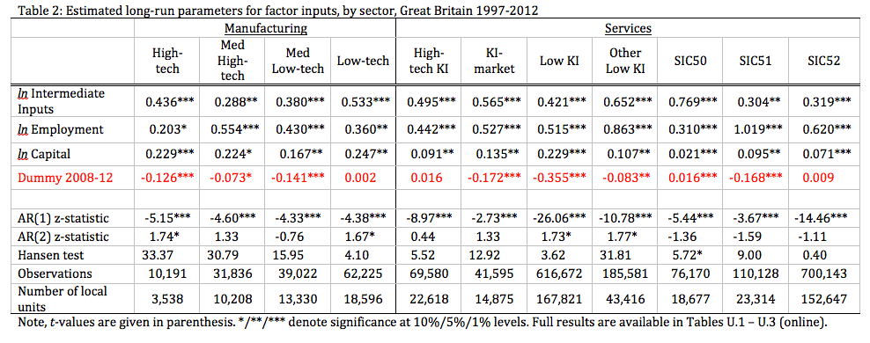

Slide 8
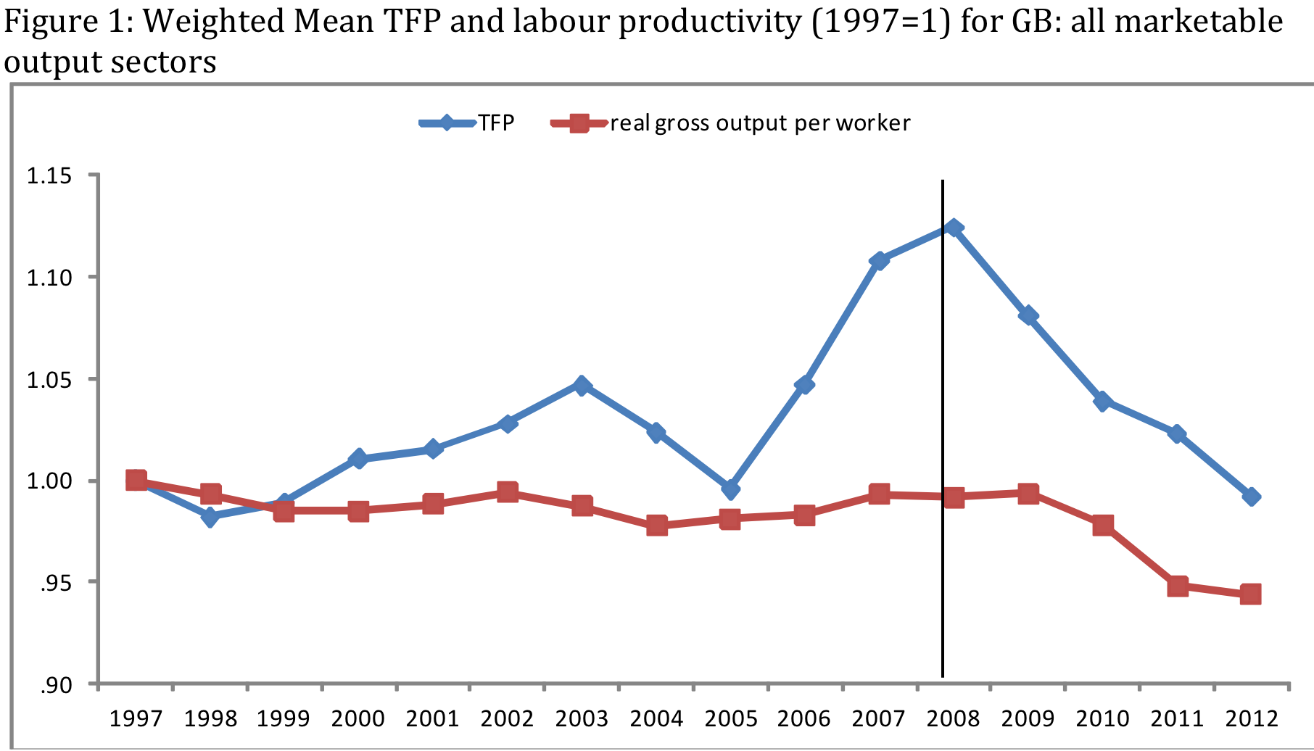
Productivity levels post-2007

Slide 9
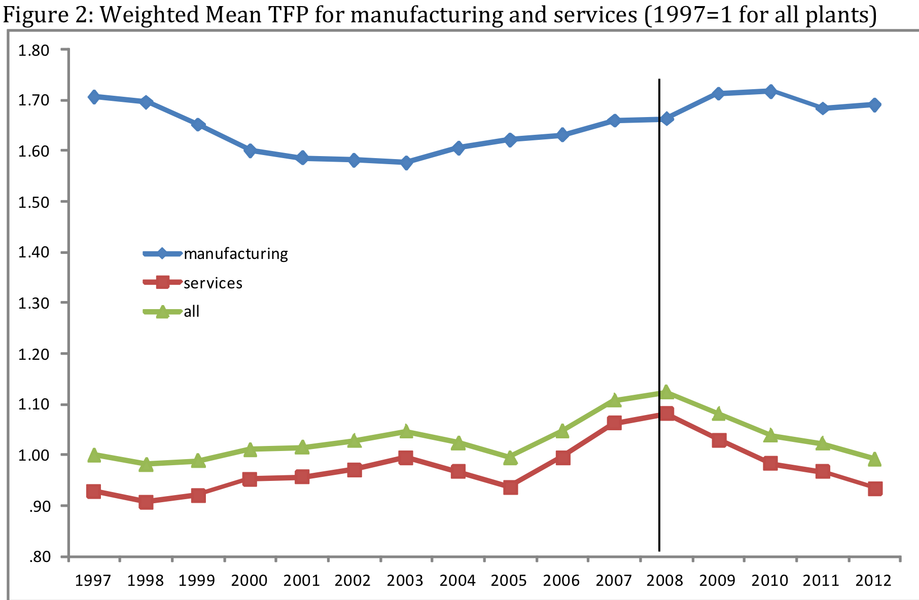
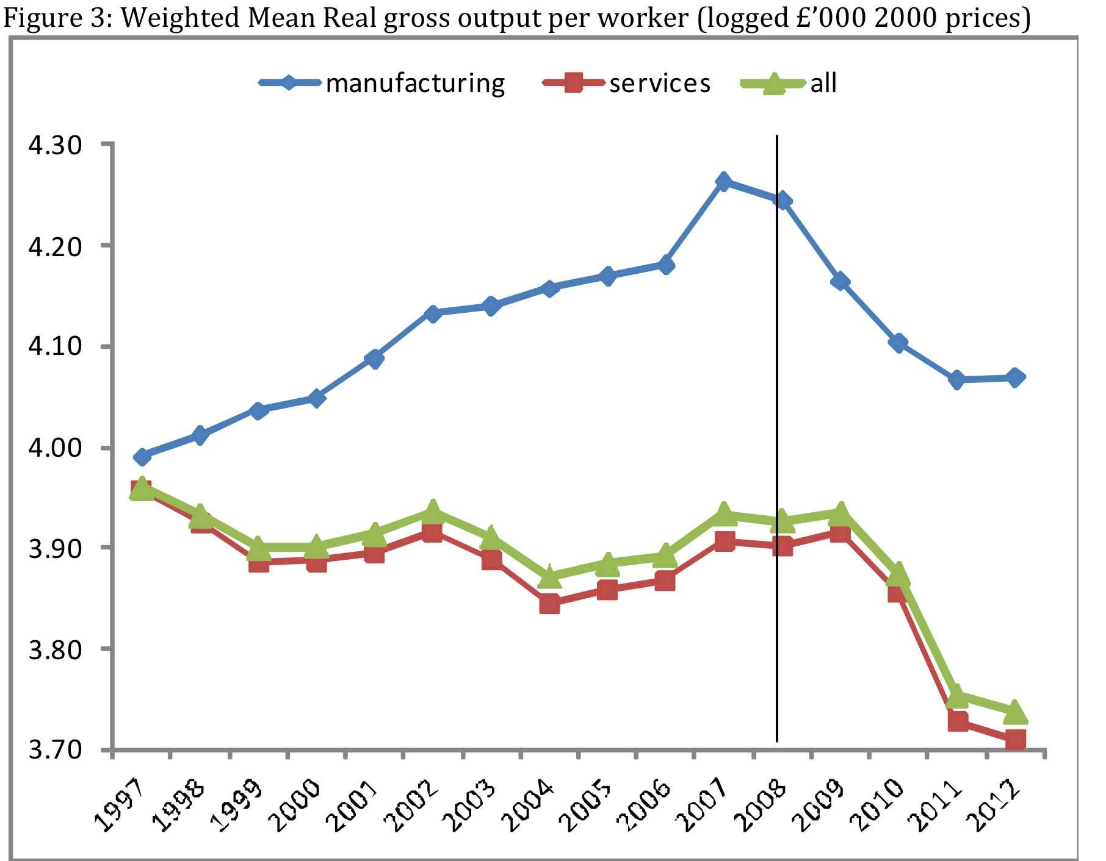

Slide 10
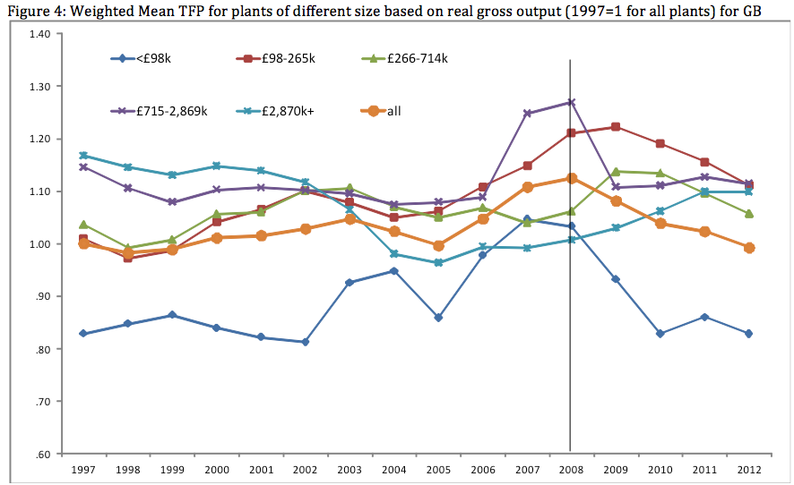

Slide 11
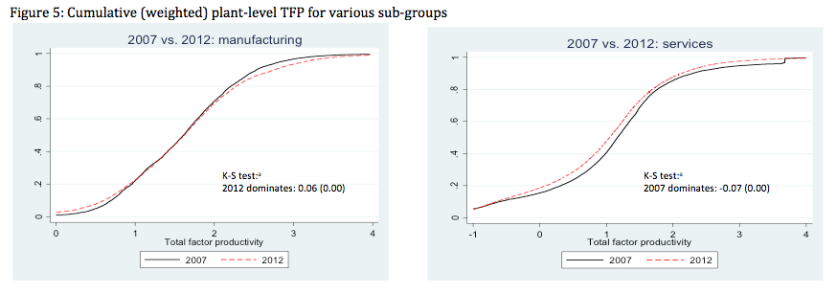
In summary, the results presented show that:
‘composition’ is an important part of the explanation of the (TFP) ‘productivity puzzle’
  larger, manufacturing plants less likely to have experienced any significant decline in productivity post-2007, especially if they were foreign-owned.
a TFP productivity puzzle is mostly confined to a smaller, service sector plants phenomenon.

Slide 12
Reconciling differences in the levels of labour productivity and TFP
Consider first those plants in operation in both years (the continuers)
Later, we consider productivity in plants that entered post-2007 or ceased production before 2012.

Slide 13
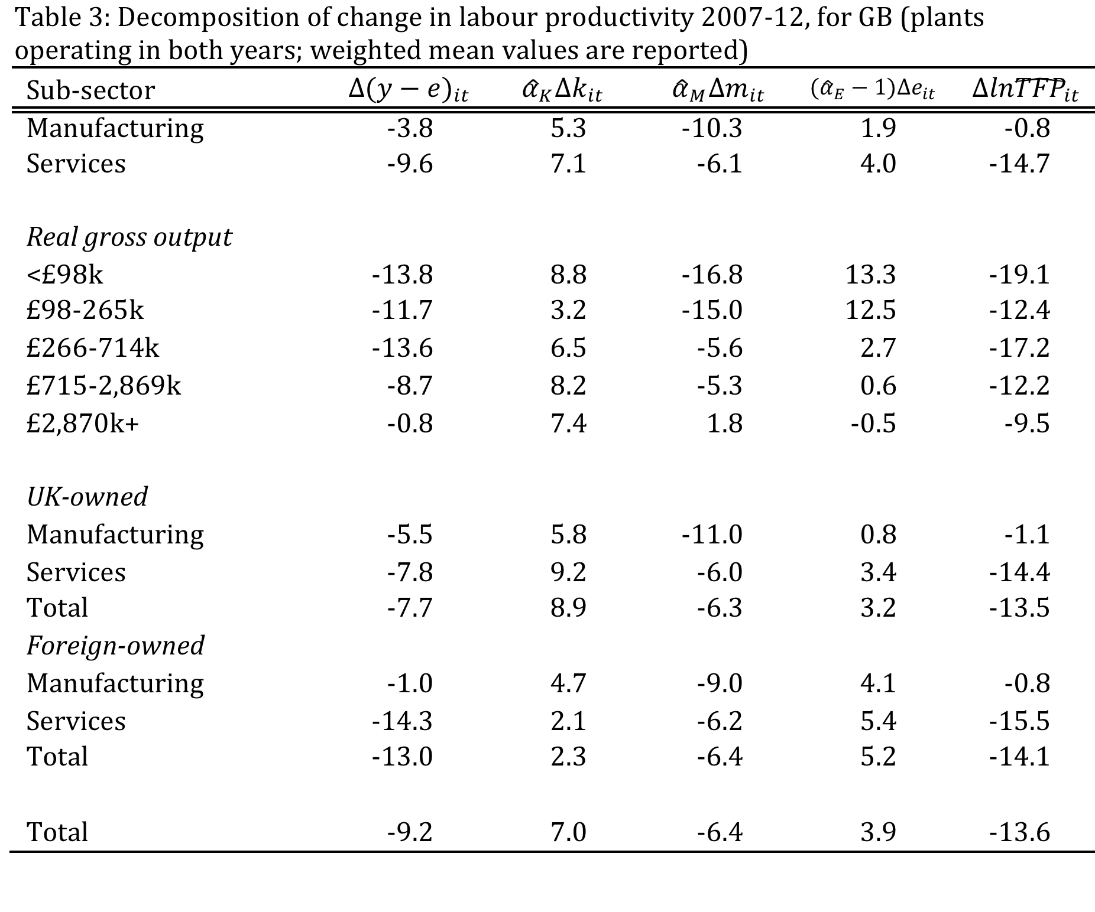

Slide 14
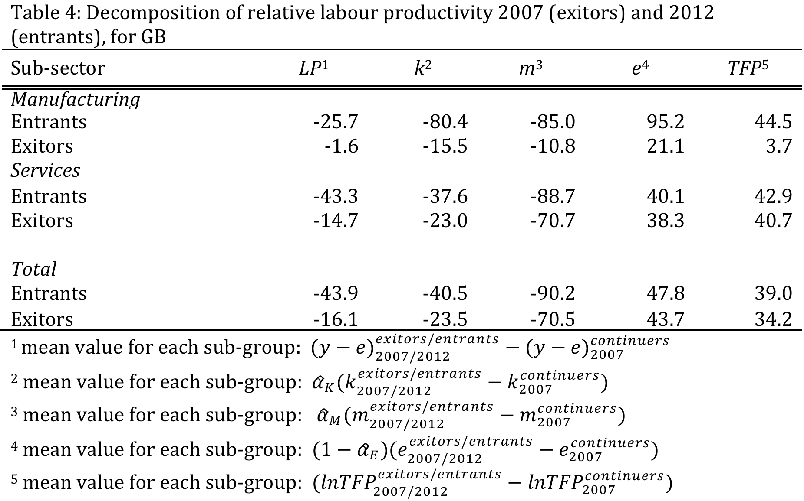

Slide 15
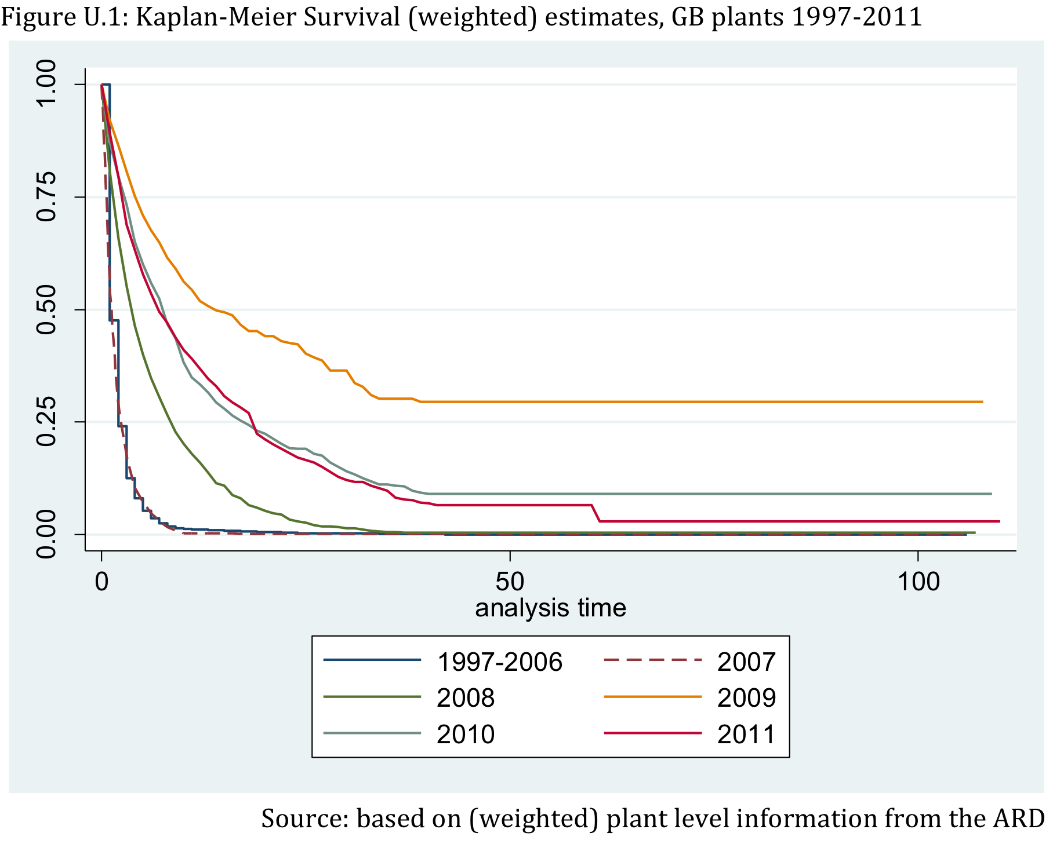

Slide 16
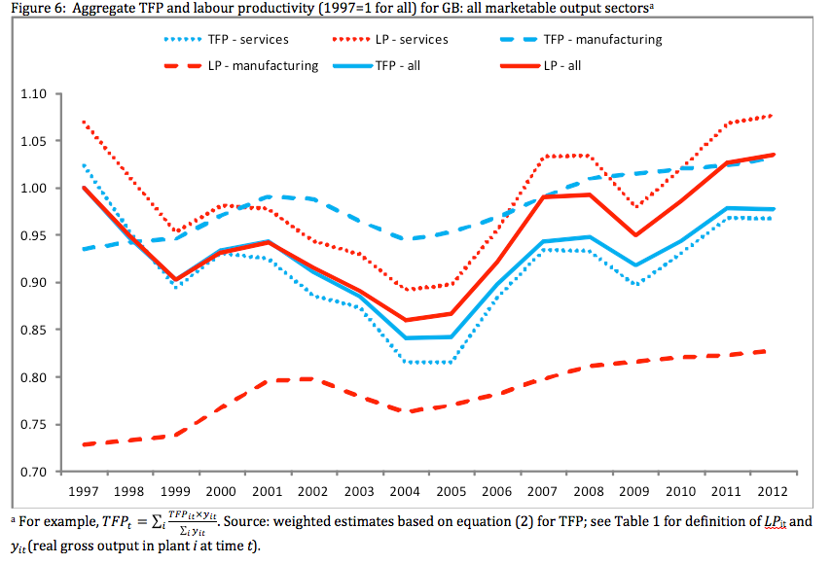
Changes in productivity levels and in output shares

Slide 17
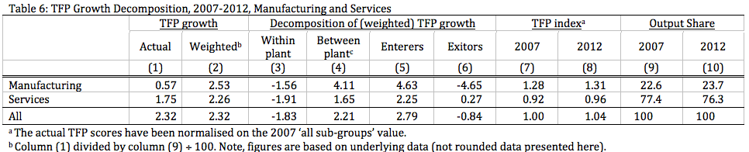
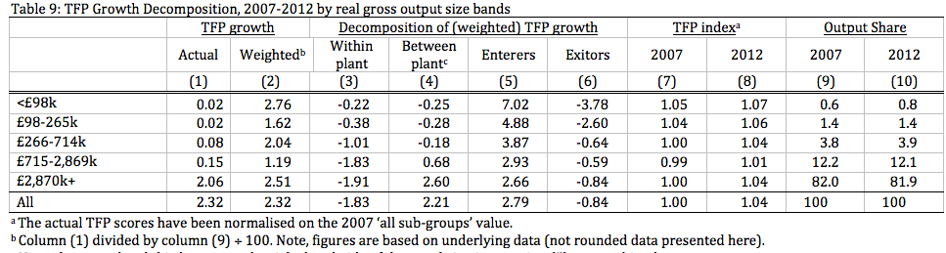

Slide 18
Conclusions
For labour productivity:
  both manufacturing and service sectors experienced a substantial and sustained decline of around 4.5-5 per cent, post-2007.
For TFP
  no evidence of any ‘productivity puzzle’ in manufacturing
  the entire post 2008 decline in TFP was accounted for by services.
    also confined to smaller plants (especially the very smallest)
For LP during 2007-2012 based upon changes in factor inputs and TFP:
  manufacturing plants that operated in both 2007 and 2012 linked to a ‘factor proportions’ story
    but not falls in the capital-labour ratio (which actually rises). Instead there was a substantial decline in the intermediate inputs-labour ratio
  service sector decline in 2007-12 in LP (nearly 10 per cent for continuing plants) was explained by a much greater fall in TFP (nearly 15 per cent)
  Entry:
    LP was on average nearly 44 per cent lower than for plants in 2007 that continued in operation until 2012 – this was due to these plants being smaller BUT also had 39 per cent higher TFP compared to incumbents
  Exit:
    LP (around 16 per cent lower) because they were on average also relatively small plants, but they also had 34 per cent higher TFP than continuers
    using a simple hazard model we also found the rate of plant closure declined in this period

Slide 19
when plant level productivity in each year was weighted by the plant’s share in total output to provide aggregate figures
  we were able to show that both aggregate LP and TFP were on a general upward trend between 2005 and 2012
  shows that reallocation of output shares across plants had an important positive effect
    mitigating the impact of declines in TFP that were experienced by the majority of plants (especially in services) post-2007

Slide 20
Thank you

